Slide 1
第二十三章 汽车转向系统
Chapter twenty-three Steering system

Slide 2
主要内容
Main contents
概述；Introduction；
转向操纵机构；Steering control mechanism；
转向器；Steering gear；
转向传动机构；Steering transmission mechanism ；
液压助力转向系统；Hydraulic power steering system；

Slide 3
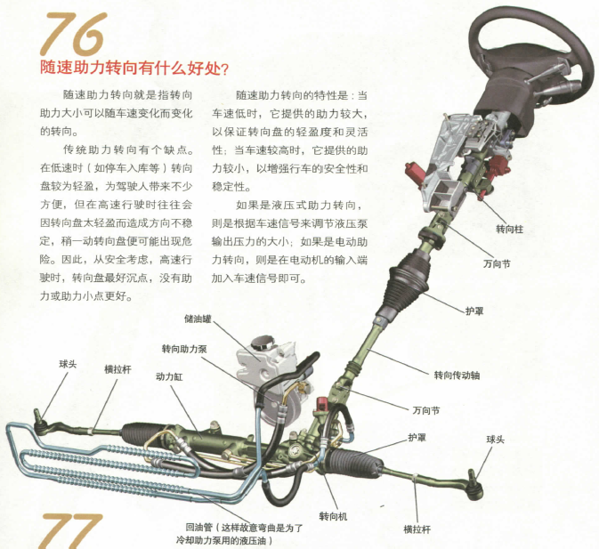
第一节 概述
First quarter: Inroduction
汽车转向系统的定义：汽车中用来改变或者恢复其行驶路线的系统。Definition of steering system：System in car which is used to change or regain its drive path.

Slide 4
汽车转向系统的功用、类型
Functions and types of steering system
汽车转向系统的功用：保证汽车按驾驶员的要求进行转向和正常行驶。Function of steering system：Ensure the car can steering and driving normally according to the driver’s request.
按汽车转向系统能源
According to the energy of steering system of car
机械转向系统Manual steering system
动力转向系统Power steering system
以驾驶员的体力为转向能源，其中所有的传力件都是机械零件。Take the driver’s physical strength as the steering energy, in which all the transmission parts are mechanic parts.
兼用驾驶员的体力和发动机动力为转向能源，其转向系统中需要增加动力转向装置。Take both the driver’s physical strength and the power from the engine as the steering energy. And power steering device should be added to the steering system.

Slide 5
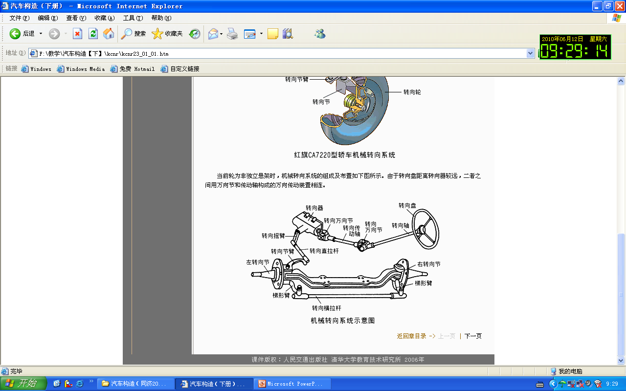
机械转向系统的组成
Components of manual steering system
机械式转向系统主要由转向操纵机构、转向器和转向传动机构组成。
Manual steering system mainly includes: steering control mechanism、steering gear and steering transmission mechanism.
从转向盘到转向器（不包括转向器）的一系列零部件属于转向操纵机构，由转向摇臂至转向梯形的一系列零部件（不含转向节）属于转向传动机构。
A series of parts (not includes knuckle) from pitman arm to steering trapezium belongs to steering transmission mechanism.

Slide 6
机械转向系统的组成
Components of manual steering system
转向操纵机构Steering control mechanism
方向盘Steering wheel
转向管柱Steering column
转向万向节Steering universal joint
转向传动机构Steering transmission mechanism
转向摇臂Pitman arm
转向拉杆Steering track rod
转向节臂Knuckle arm
转向梯形机构Steering trapezium
转向万向节的作用Functions of steering universal joint
方便布置；Easy to place；
消除安装误差和安装支架变形引起的不利影响；Eliminate bad effects caused by installation error and installation holder deformation;
可以方便的实现零部件的通用化和系列化。Can easily achieve the generalization and serialization of parts.

Slide 7
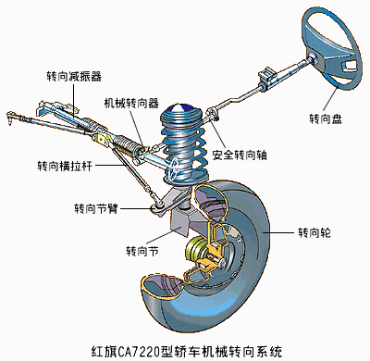
机械转向系统的组成
Components of manual steering system

Slide 8
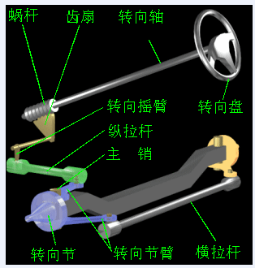
机械转向系统的组成(视频)
Components of manual steering system (video)

Slide 9
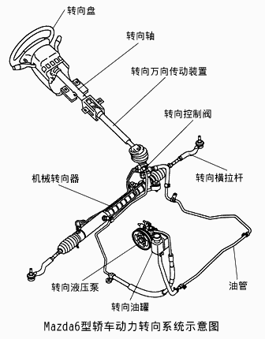
动力转向系统的组成
Components of power steering system
机械转向装置：转向操纵装置、转向器、转向传力装置。Mechanic steering device: steering control mechanism, steering gear and steering transmission device.
动力转向装置：转向油罐、转向油泵、转向控制阀、转向动力缸。Power steering device: steering oil reservoir, oil pump, steering control valve, steering power cylinder(Mechanical steering gear).
转向轴带动转向控制阀转动，使转向动力缸活塞一侧接通压面压力为零的转向油罐，另一侧接通高压油泵出油口，推动活塞杆移动。Steering shaft drives steering control valve to rotate, make one side of steering power cylinder’s piston connected to steering oil reservoir which pressure is zero and the other side of piston connected to oil-out of high pressure oil pump and push the piston rod to move.
转向加力装置失效时，应能由驾驶员独立承担转向任务。When the power steering device loses efficacy, it should be able to steering by driver alone.

Slide 10
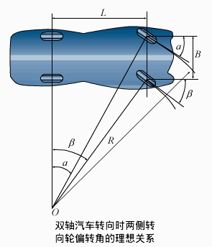
两侧车轮偏转角之间的理想关系Ideal relationship between deflection angle of both sides wheel
为避免在汽车转向时加大对车轮的磨损，希望汽车转向时每个车轮都作纯滚动。即要求所有车轮的轴线都相交于一点。To avoid increasing wheel’s wear when steering, Each wheel’s pure rolling is excepted when steering. That is every wheel’s axis should intersect in one point.
B—两侧主销轴线与地面相交点的距离；B—distance of intersection between kingpin axis on both sides and ground;
L—汽车的轴距；L—wheel base of car；
R—为汽车转向半径；R—turning radius of car；
O—为汽车转向中心O—turning center of car.
汽车内轮转角β与外轮转角α之间的关系如下：
cotα=cotβ+B/L
Relationship between steering angle of inside wheel β and outside wheel α.
cotα=cotβ+B/L

Slide 11
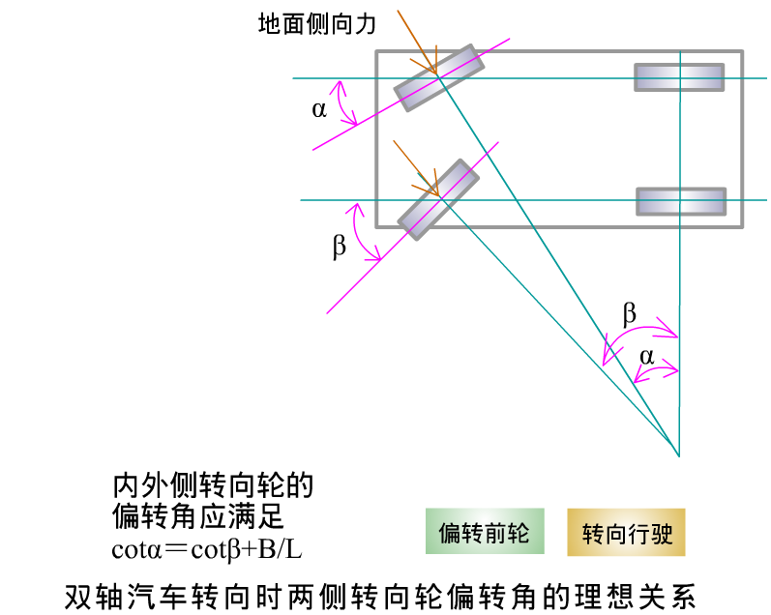
两侧车轮偏转角之间的理想关系Ideal relationship between deflection angle of both sides wheel
转向梯形要合理设计。Steering trapezium should be designed reasonably.

Slide 12
两侧车轮偏转角之间的理想关系Ideal relationship between deflection angle of both sides wheel
汽车转弯半径 R=L/sinα
Turning radius of car R=L/sinα
汽车最小转弯半径：当外转向轮偏转角α达到最大值α_{max}时，转向半径最R_{min}
R_{min}=L/sin(α_{max})
Minimum turning radius of car: When the outside steering wheel’s deflection angle comes to its maximum value α_{max}, turning radius comes to its minimum value:
R_{min}=L/sin(α_{max})
只用前轴转向的三轴汽车，由于中、后轮总是平行的，因此不存在理想的转向中心；Three-axle car which only use front axle to turn, as the middle and back wheel is always parallel, therefore no ideal turning center exists.
计算转向中心时用一个与中、后轴线等距的平分线作为假想轴线。Equidistant bisector of middle and back axle as a imaginary axle is used to calculate turning center.

Slide 13
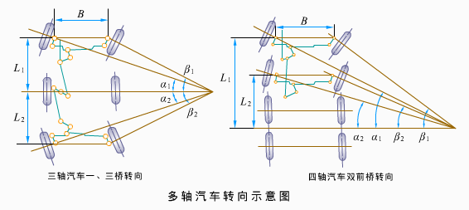
两侧车轮偏转角之间的理想关系Ideal relationship between deflection angle of both sides wheel
一、三轴为转向桥的三轴汽车，设L1、L2分别为一轴、三轴到二轴的距离。Three-axle car which take first and third axle as the steering axle. Suppose L1 and L2 is the distance from first and third axle to second axle separately.
一、二轴为转向桥的四轴汽车，以三四轴之间的平分线为转向基线， L1、L2分别为一轴、二轴到基线的距离。Four-axle car, which take first and second axle as the steering axle, take bisector between third and fourth axle as the steering basic line. L1 and L2 donates the distance from first and second axle to the basic line separately.
前轴cotα₁=cotβ₁+B/L₁
Front axle cotα₁=cotβ₁+B/L₁
后轴cotα₂=cotβ₂+B/L₂
Back axle cotα₂=cotβ₂+B/L₂
转向梯形需要满足相应的设计要求。Steering trapezium should meet relative design demands.

Slide 14
两侧车轮偏转角之间的理想关系Ideal relationship between deflection angle of both sides wheel
若设L₁=L₂=L/2,则有α₁=α₂=α β₁=β₂=β
汽车最小转弯半径：R_{min}=L/2sin(α_{max})
Minimum turning radius of car: R_{min}=L/2sin(α_{max})
仅为同轴距前轮转向双轴汽车转弯半径的一半。Only half of the same wheel base, front axle steering and double axle car’s turning radius.

Slide 15
转向系的角传动比
Steering system angle ratio
转向盘Steering wheel
转向器Steering gear
转向摇臂Pitman arm
转向节Knuckle
转向传动机构角传动比i_{ω2}Steering transmission mechanism angle ratio i_{ω2}
转向器角传动比i_{ω1}
Steering gear angle ratio i_{ω1}
转向系角传动比i_{ω}Steering system angle ratio i_{ω}
i_{ω}= i_{ω1}*i_{ω2}
转向系角传动比越大，转向越省力，但转向灵敏度降低。The more bigger the steering system angle ratio is ,the more easy of steering. But steering sensitivity will lower.
对于一般汽车，转向传动机构角传动比i_{ω2}约为1 ，转向系统角传动比主要取决于i_{ω1}。货车为16~32，轿车为12-~20。For general car, steering transmission mechanism angle ratio i_{ω2} is about 1. Steering system angle ratio mainly depend on i_{ω1}.Truck’s angle ratio is 16 to 32. Car ‘s angle ratio is 12 to 20.

Slide 16
转向盘的自由行程Free travel of steering wheel
定义：转向盘空转阶段的行程，称为转向盘的自由行程。Definition: route of steering wheel’s idle period is called free travel of steering wheel.
自由行程产生的原因：转向系统中个传动件之间存在安装间隙。The reason why free travel exists: mounting clearance between transmission parts in steering system.
转向盘自由行程的作用：可以缓和路面冲击，避免驾驶员过分的紧张和疲劳；但过大转向盘自由行程会降低转向灵敏度，一般为10~15°。
Function of free travel of steering wheel: can alleviate impact from road, avoid driver’s overstress and tired. But too big free travel of wheel will lower steering sensitivity. Normally form 10° to 15°.

Slide 17
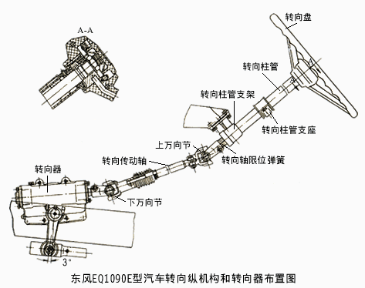
第二节 转向操纵机构
Second quarter: Steering control mechanism

Slide 18
转向操纵机构的组成和布置
Components and layout of steering control mechanism
转向盘到转向器之间的所有零部件总称为转向操纵机构。All parts from steering wheel to steering gear are called steering control mechanism.

Slide 19
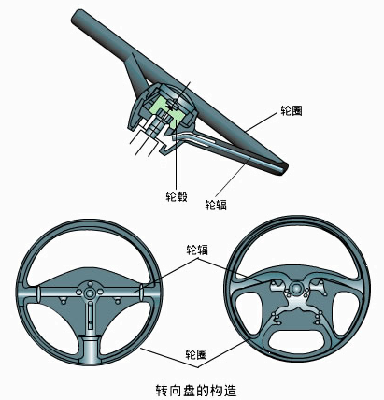
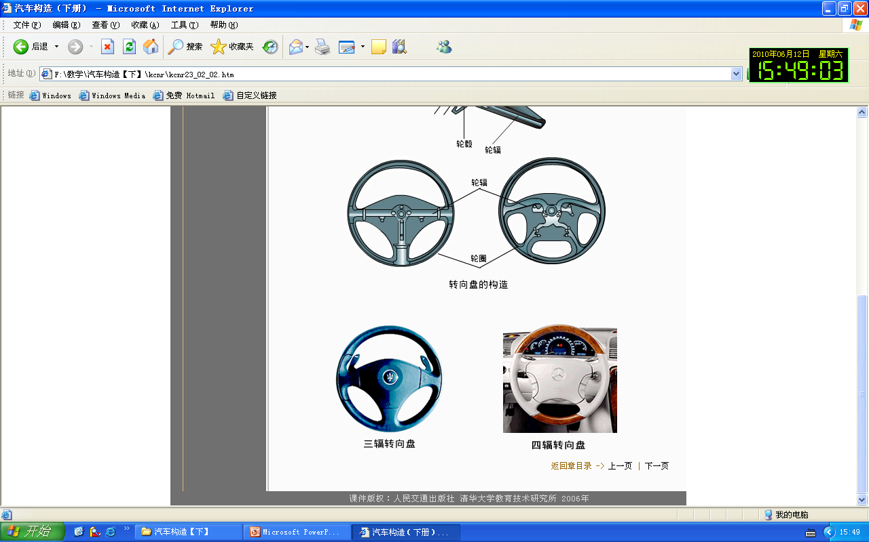
转向盘Steering wheel
组成：轮缘、轮辐、轮毂。Components：rim, spoke, hub.
转向盘轮毂的细牙内花键与转向轴连接。 Fin thread inner spline of steering wheel’s hub is connected to steering shaft.
转向盘内部由成形的金属骨架构成，外面包有柔软的橡胶或树脂。 Interior of steering wheel is made up of formed mental frame. Its exterior are covered by rubber and resin.
转向盘上都装有喇叭按钮，有些轿车的转向盘上还装有车速控制开关和安全气囊。Steering wheel is all equip with horn button. Some even equip with speed control button and ABRS(air bag restraint system).
转向盘要有缓冲吸能特性。Steering wheel should can buffer and absorb energy.

Slide 20
转向轴和转向柱管及其吸能装置Steering shaft and column and its energy absorber
转向轴是连接转向盘和转向器的传动件，用以传递转矩。Steering shaft is transmission part which connect steering wheel and steering gear. It’s used to deliver torque.
转向柱管固定在车身上，转向轴从转向柱管中穿过，支承在柱管内的轴承和衬套上。 Steering column is fixed on body. Steering shaft pass through steering column and supported on bears and bush in column.
转向柱管必须装备能够缓和冲击的吸能装置。Steering column must equip with energy absorber which can alleviate impact.
吸能装置的基本工作原理是：当转向轴受到巨大冲击而产生轴向位移时，通过转向柱管或支架产生塑性变形、转向轴产生错位等方式，吸收冲击能量。 Basic working principle of energy absorber is: when steering shaft bears big impact and emerges axial displacement, absorb impact energy through steering column or support’s plastic deformation or steering shaft’s dislocation.

Slide 21
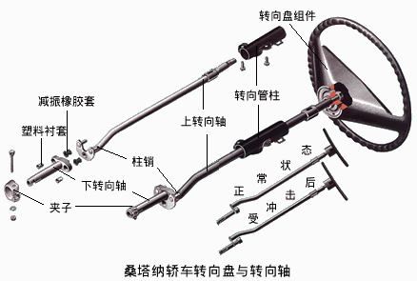
转向轴错位缓冲Steering shaft’s dislocation buffer

Slide 22
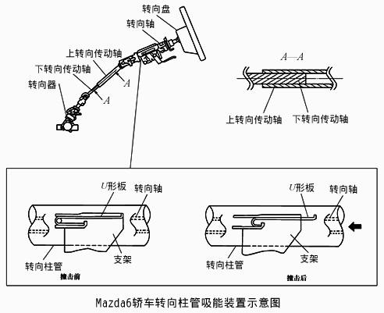
转向轴错位和支架变形缓冲
Steering shaft’s dislocation and support deformation buffer

Slide 23
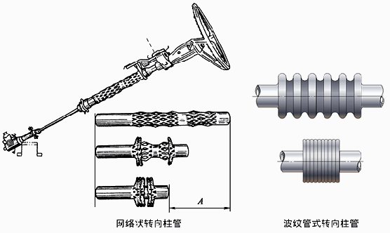
转向柱管变形吸收冲击能量并缓冲
Steering column deform to absorb impact energy and buffer
Nets structure
Bellows structure

Slide 24
第三节 转向器
Third quarter: steering gear
转向器的传动效率Transmission efficiency of steering gear
转向器的传动效率：转向器的输出功率与输入功率的比值称为转向器的效率。Transmission efficiency of steering gear: the ratio between output power and input power of steering gear is called efficiency of steering gear.
转向器的传动效率可分为正效率和逆效率。Transmission efficiency of steering gear can be fall into forward efficiency and reverse efficiency.
转向器的正效率：功率由转向轴输入，转向摇臂输出的传动效率为正效率。Forward efficiency of steering gear: Power is input from steering shaft and output by pitman arm. Transmission efficiency in this circumstance is called forward efficiency.
转向器的逆效率：功率由转向摇臂输入，转向轴输出的传动效率为逆效率。Reverse efficiency of steering gear: Power is input from pitman arm and output by steering shaft. Transmission efficiency in this circumstance is called reverse efficiency.

Slide 25
转向器的传动效率Transmission efficiency of steering gear
逆效率很高的转向器称为可逆式转向器，逆效率很低的转向器称为不可逆的转向器，逆效率略高于不可逆式的转向器称为极限可逆式转向器。Steering gear with high reverse efficiency is called reversible steering gear. That with lower reverse efficiency is called irreversible steering gear. Reverse efficiency is just a little high then irreversible steering gear is called ultimate reversible steering gear.
可逆式转向器、不可逆转向器与极限可逆式转向器的比较Comparison among reversible, irreversible and ultimate reversible steering gear
可逆式转向器可以将路面阻力完全反馈到转向盘，驾驶员路感好，可以实现方向盘的回正，但可能发生“打手”现象；Reversible steering gear can feedback road resistance to steering wheel totally. The driver can have good road feeling. It can realizes aligning of steering wheel. But may results the phenomenon of hit hand.
不可逆式转向盘让驾驶员丧失路感，无法根据路面阻力调整方向盘转距，方向盘不会回正。Irreversible steering wheel let driver lose road feeling and can not adjust steering wheel’s torque according to road resistance. Steering wheel can not realizes aligning.
极限可逆式转向器可以获得一定的路感，转向盘可自动回正。Ultimate reversible steering gear can get certain road feeling, steering wheel can realizes aligning.
不可逆式转向器应用较少，现代汽车大部分采用可逆，部分越野车辆采用极限可逆式转向器。Irreversible steering wheel is used rarely. The reversible one are used in most modern cars. Some off-road vehicle uses the ultimate reversible steering gear.

Slide 26
转向器的分类Types of steering gear
齿轮齿条式转向器Rack and pinion steering gear
循环球式转向器Re-circulating ball steering gear
蜗杆曲柄指销式转向器Worm crankpin steering gear

Slide 27
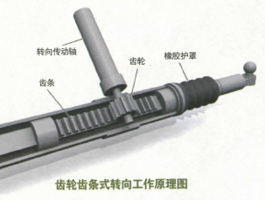
齿轮齿条式转向器
Rack and pinion steering gear
齿轮齿条式转向器的传动件为齿轮和齿条。Rack and pinion steering gear’s transmission parts are pinion and rack.

Slide 28
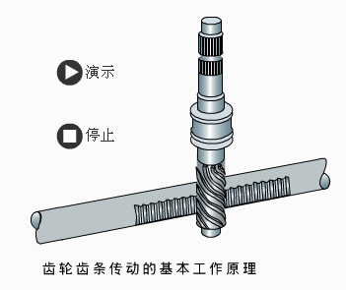
齿轮齿条式转向器
Rack and pinion steering gear

Slide 29
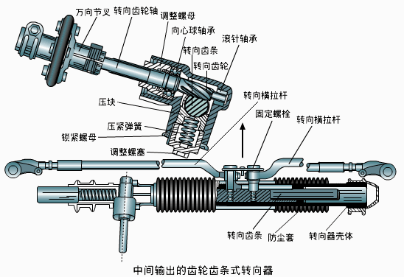
齿轮齿条式转向器
Rack and pinion steering gear

Slide 30
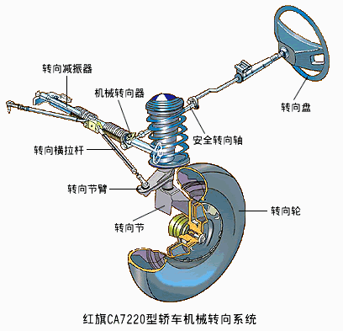
齿轮齿条式转向器
Rack and pinion steering gear
特点Character
结构简单，紧凑；Simple structure and tight；
质量轻；Light mass;
转向灵敏；Turning is sensitive；
制造容易，成本低；Easy to make and low cost；
正、逆效率高。Forward and reverse efficiency are high
转向传动机构简单，不需要转向摇臂和直拉杆。Steering transmission mechanism is simple. Do not need pitman arm and drag link 。
特别适用于与烛式和麦弗逊式独立悬架配用Particular suitable for candle suspension and McPherson independent suspension.

Slide 31
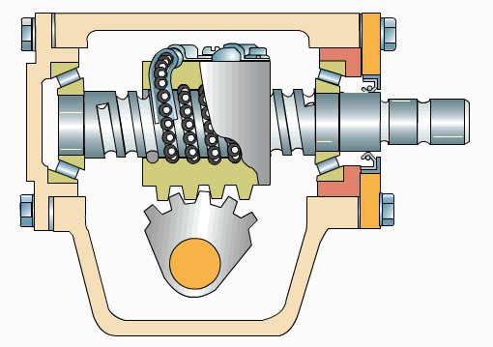
循环球式转向器
Re-circulating ball steering gear
Steering screw转向螺杆
Ball钢球
Steering shaft 转向轴
Angular contact thrust ball bearing
推力角接触球轴承
Pre-stressing and adjusting shim of bearing轴承预紧度调节垫片
Steering nut
转向螺母
Sector齿扇
Sector shaft 齿扇轴

Slide 32
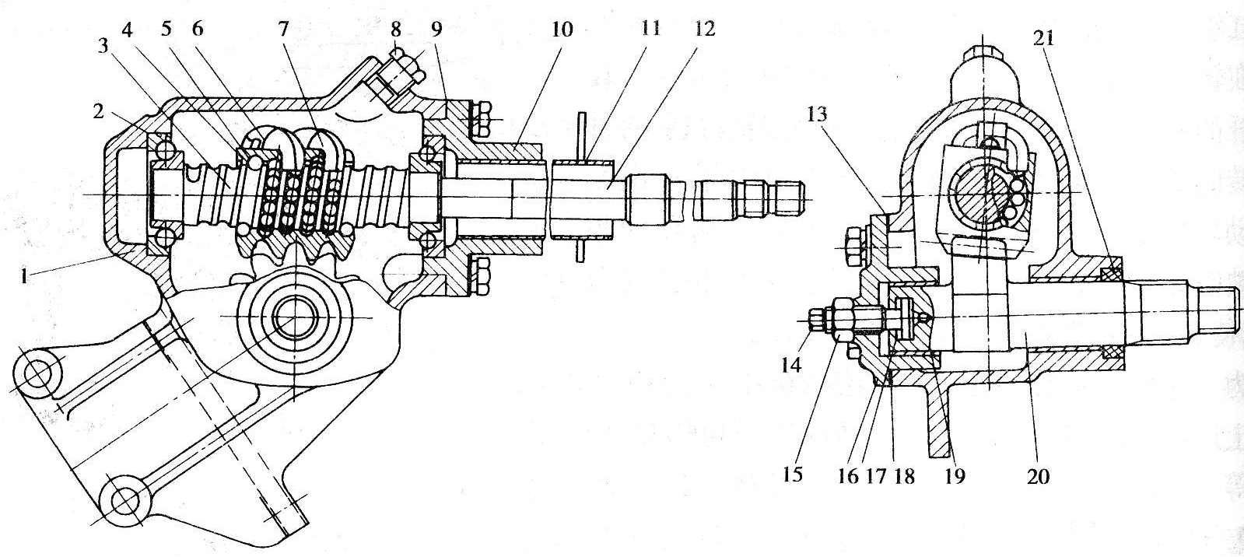
循环球式转向器
Re-circulating ball steering gear
齿扇的齿厚在分度圆上沿齿扇轴线按线性关系变化。Tooth thickness of sector changes in linear relationship along axle of sector on reference circle.
啮合间隙调整螺钉Backlash adjusting screw

Slide 33
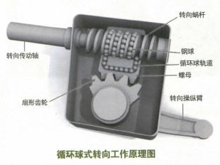
循环球式转向器
Re-circulating ball steering gear
转向螺杆转动时，通过钢球力传。When steering screw rotating, pass force by ball.

Slide 34

循环球式转向器
Re-circulating ball steering gear
一般采用两级传动：第一级为螺杆螺母传动副，第二级为齿条齿扇传动副。Double-stage driving are adopted: the first one is transmission pair between screw and nut. The second one is transmission pair between rack and sector.

Slide 35
循环球式转向器
Re-circulating ball steering gear
特点Character
正传动效率高达90%~95%，转向省力；Forward efficiency reaches up to 90%~95%, easy to turning.
寿命长，工作平稳；Long lifetime，reliable working.
逆效率也很高，容易打手,但对于前轴荷小、行驶路面好的汽车影响不大。Reverse efficiency is high too. Easy to hit hand. But the impact is not big for car with small front axle load and good driving road.

Slide 36
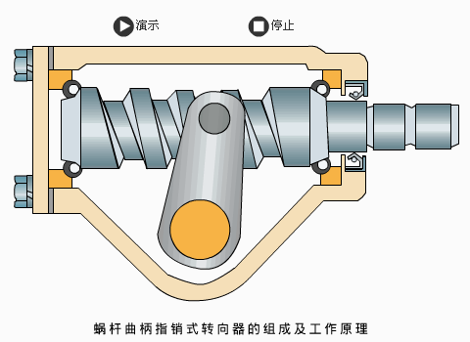
蜗杆曲柄指销式转向器
Worm and peg steering gear
传动副的组成：转向蜗杆(主动件) 和指销(从动件)。Components of transmission pair: steering worm (driving link) and crankpin (driven link).

Slide 37
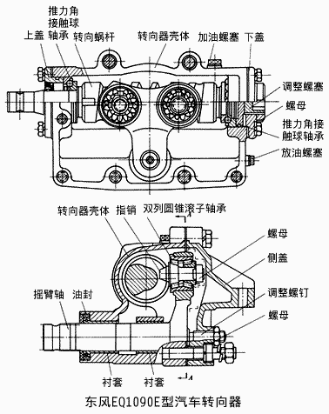
蜗杆曲柄指销式转向器
Worm and peg steering gear
调整螺塞用以调整支承蜗杆的角接触球轴承预紧度。Adjusting plug screw is used to adjust angular contact thrust ball bearing pre-stressing of support worm.
双指销式转向器的特点Character of double-peg steering gear
大多情况两指均参与啮合。每个指销所承受的载荷小，因此寿命长；The two peg joins in meshing in most circumstance. Every peg bears little load. So it has long lifetime.
结构复杂，对蜗杆加工精度要求高。Complicated structure. High machining accuracy of worm are required.
双指销式转向器Double-peg steering gear

Slide 38
第四节 转向传动机构
Fourth quarter: Steering transmission mechanism
从转向器到转向节之间的所有传动杆件总称为转向传动机构。All transmission links from steering gear to steering knuckle are called Steering transmission mechanism 。
转向传动机构的功用是将转向器输出的力和运动传到转向桥两侧的转向节，使转向轮偏转，并使两转向轮偏转角按一定关系变化，以保证汽车转向时车轮与地面的相对滑动尽可能小。 Function of steering transmission mechanism is to deliver force and movement which steering gear outputs to knuckles on sides of steering axle. Make steering wheel deflect and two deflection angle of steering wheel change in certain relationship. To ensure relative slip between wheel and ground takes the tiniest when steering.
转向传动机构的组成与布置因转向器位置和转向轮悬架类型不同而不同。Components and layout of steering transmission mechanism diverse for location of steering gear and steering wheel’s suspension type.

Slide 39
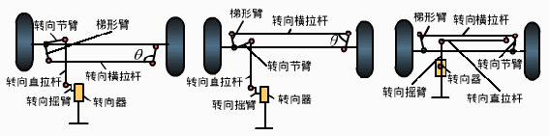
与非独立悬架配用的转向传动机构Steering transmission mechanism with dependent suspension
转向传动机构由转向摇臂、转向直拉杆、转向节臂和转向梯形等零部件组成，其中转向梯形由梯形臂和转向横拉杆构成。Steering transmission mechanism consists of pitman arm, steering drag link, steering knuckle arm, steering trapezium and so on, where steering trapezium consists of tie rod arm and tie rod。
前桥仅为转向桥。Front axle is only used as steering axle.
前桥为转向驱动桥或发动机位置较低。Front axle is steering drive axle or low position of engine.
转向摇臂在水平面内摆动。Pitman arm swings in horizontal plane.

Slide 40
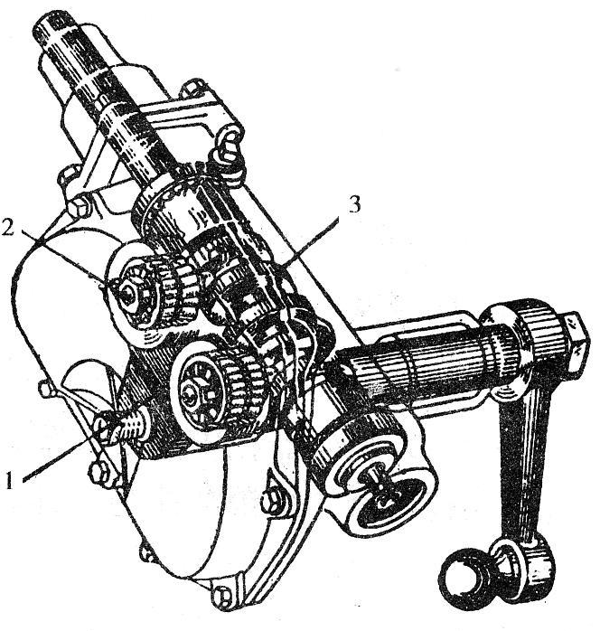
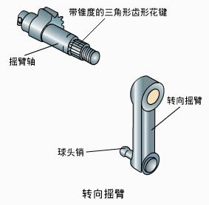
转向摇臂Pitman arm
循环球式转向器和蜗杆曲柄指销式转向器通过转向摇臂与转向直拉杆相连。Re-circulating ball steering gear and worm and peg steering gear are connected by pitman arm and steering drag link.
转向摇臂的大端用锥形三角细花键与转向器中摇臂轴的外端连接，小端通过球头销与转向直拉杆作空间铰链连接。Big end of pitman arm is connected to outboard of pitman arm shaft in steering gear with tapered triangular fine spline. Its small end is connected to steering drag link as space hinge by ball stud.

Slide 41
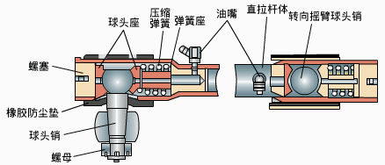
转向直拉杆Steering drag link
转向直拉杆是转向摇臂与转向节臂之间的传动杆件。Steering drag link is the transmission link between pitman arm and knuckle arm.
在转向轮偏转且因悬架弹性变形而相对于车架跳动时，转向直拉杆与转向摇臂及转向节臂的相对运动都是空间运动，为了不发生运动干涉，三者之间的连接件都是球形铰链。When steering wheel deflect and jump relative to frame as the deforming of suspension, relative movement among steering drag link, pitman arm and knuckle arm is space movement. To avoid motion interference, the connection among them is spherical linkage.
弹簧作用:补偿球头与座的磨损并缓解转向节传来的冲击。Function of spring: compensate abrade between bulb and seat, alleviate the impact from knuckle.

Slide 42
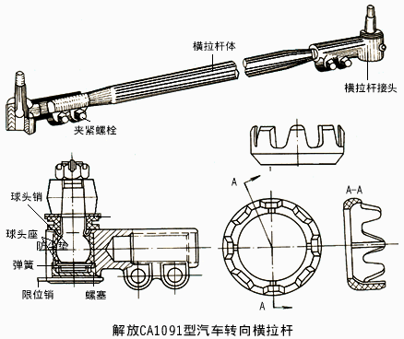
转向横拉杆Steering tie rod
转向横拉杆是转向梯形机构的底边，由横拉杆体和旋装在两端的横拉杆接头组成。 Steering tie rod is the base of trapezoidal steering mechanics. It consists of body of tie rod and joint of tie rod which is rotational mounted to both sides.
特点：两端螺纹，一端为左旋，另一端为右旋，长度可调，通过调整横拉杆的长度，可以调整前轮前束。 Character: Thread in both sides. One side is left hand. Other side is right hand. Adjustable length. Can adjust toe-in of front wheel through change length of tie rod.
转向横拉杆与梯形臂用球头销连接。 Tie rod is connected to trapezoidal arm with ball pin.
弹簧保证两球头座与球头紧密接触，并起缓冲作用。 Spring ensures two ball cups contact with bulb tightly and absorb the impact.

Slide 43
与独立悬架配用的转向传动机构Steering transmission mechanism with independent suspension
当转向轮采用独立悬架时，转向桥是断开式的，转向传动机构中的转向梯形也必须断开。
When dependent suspension is adopted in steering wheel, steering axle is divided. Steering trapezium in steering transmission mechanism must be divided too.
与独立悬架配用的多数是齿轮齿条式转向器，转向器布置在车身上，转向横拉杆通过球头销与齿条及转向节臂相连。
Rack and pinion steering gear is often used in dependent suspension. Steering gear is placed on car body. Tie roe is connected to rack and knuckle arm by ball pin.

Slide 44
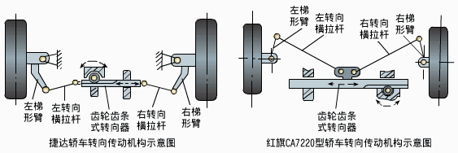
与独立悬架配用的转向传动机构Steering transmission mechanism with independent suspension
Left trapezoidal arm
Right trapezoidal arm
Left tie rod
Right tie rod
Left trapezoidal arm
Left tie rod
Rack and pinion steering gear
Right trapezoidal arm
Rack and pinion steering gear
Right tie rod
Schematic diagram of steering transmission
mechanism of JieDa car
Schematic diagram of steering transmission
mechanism of HongQi CA7220 car

Slide 45
与独立悬架配用的转向传动机构
Steering transmission mechanism with independent suspension
当采用循环球式转向器时，转向传动机构的杆件较多。
When adopt re-circulating ball steering gear, there are much more links in steering transmission mechanism.

Slide 46
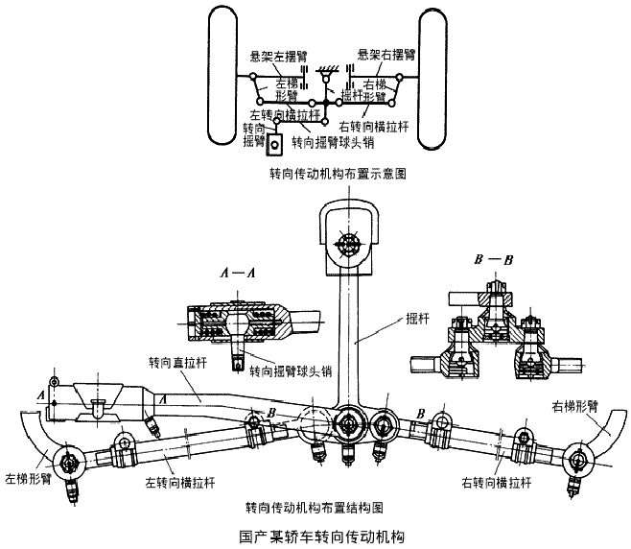
与独立悬架配用的转向传动机构
Steering transmission mechanism with independent suspension

Slide 47
与独立悬架配用的转向传动机构
Steering transmission mechanism with independent suspension
Left rocker of suspension
Right rocker of suspension
Left trapezoidal arm
rocker
right trapezoidal arm
Left tie rod
g
Right tie rod
Pitman arm
Pitman arm ball pin
Layout of steering transmission mechanism
rocker
Drag link
Pitman arm ball pin
Right trapezoidal arm
Left trapezoidal arm
left tie rod
Right tie rod
Layout of steering transmission mechanism
Steering transmission mechanism of one domestic car

Slide 48
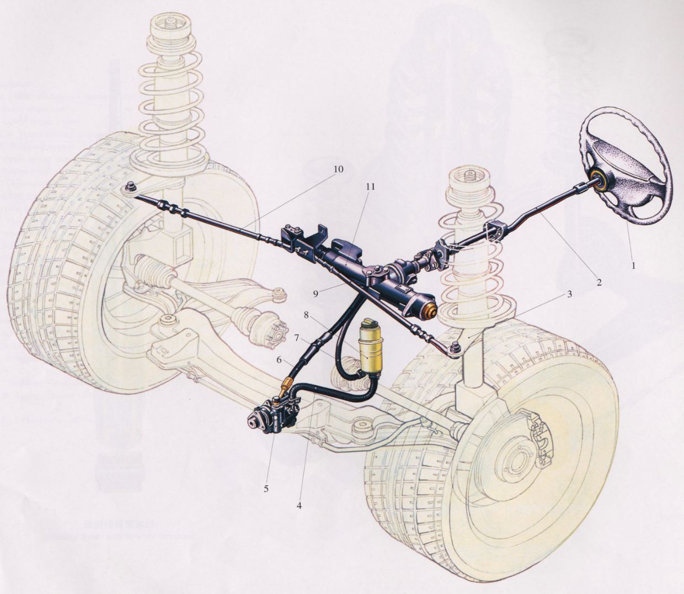
与独立悬架配用的转向传动机构
Steering transmission mechanism with independent suspension

Slide 49
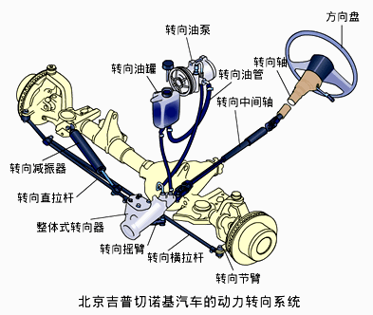
第五节 液压助力转向系统
Fifth quarter: Hydraulic power steering system
oil pump
steering wheel
steering shaft
oil reservoir
oil pipe
steering middle shaft
steering damper
steering drag link
unitary steering gear
pitman arm
steering tie rod
knuckle arm
Power steering system of Beijing Cherokee car

Slide 50
助力转向系统概述
Overview of power-assisted steering system
动力转向系统是将发动机输出的部分机械能转化为压力能（或电能），并在驾驶员控制下，对转向传动机构或转向器中某一传动件施加辅助作用力，使转向轮偏摆，以实现汽车转向的一系列装置。
Power steering system is a series of devices that convert the mechanical energy from engine to pressure energy or electricity, apply assistant force to steering transmission mechanism or some driving link in steering gear under driver’s control and make steering wheel to deflect and achieved the turning of car..

Slide 51
助力转向系统概述
Overview of power-assisted steering system
动力转向系统由机械转向器和转向加力装置组成；
Manual steering gear and steering assistant device compose the power steering system;
根据助力能源形式的不同可以分为液压助力、气压助力和电动机助力三种类型。
According to different energy types: hydraulic power, air power and motor power.
液压助力转向系统应用较为普遍，可分为常压式液压转向系统和常流式液压转向系统。
Hydraulic power steering system is used more often. It can be divided as constant pressure hydraulic power steering system and constant flow hydraulic power steering system.

Slide 52
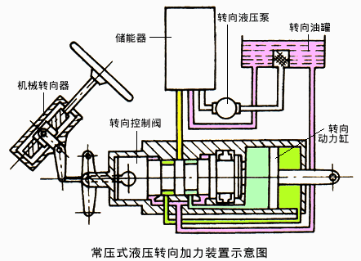
常压式液压助力转向系统
Constant pressure hydraulic power steering system
特点：无论转向盘处于中立位置还是转向位置，也无论转向盘保持静止还是运动状态，系统工作管路中总是保持高压。Character: System working pipe always stays in high pressure. No matter steering wheel is in neutral or turning status. And no matter it keeps still or in moving.
steering hydraulic pump
accumulator
oil reservoir
Manual steering gear
steering control valve
Steering power cylinder
Schematic diagram of constant pressure hydraulic power steering system

Slide 53
常流式液压助力转向系统
Constant flow hydraulic power steering system
特点：转向油泵始终处于工作状态，但液压助力系统不工作时，基本处于空转状态。多数汽车都采用常流式液压助力转向系统。
Character: Steering oil pump always keeps in working. But when hydraulic power system stop working, it keeps in idle running. Constant flow hydraulic power steering system is adopted in most cars.

Slide 54
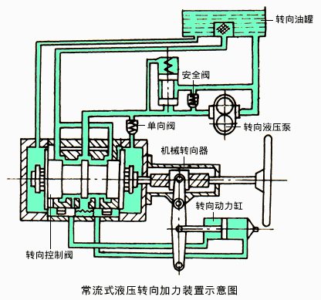
常流式液压助力转向系统
Constant flow hydraulic power steering system
oil reservoir
Safe valve
Steering hydraulic pump
One-way valve
Manual steering gear
Steering power cylinder
Steering control valve
Schematic diagram of constant pressure hydraulic power steering system

Slide 55
液压助力转向系统的转向控制阀
Steering control valve of hydraulic power steering system
阀体沿轴向移动来控制油液流量的转向控制阀，简称滑阀。
Steering control valve which valve body move along its axle to control the oil flow is called valve spool for short.
阀体绕其轴线转动来控制油液流量的转向控制阀，简称转阀。
Steering control valve which valve body rotates along its axle to control the oil flow is called rotary valve for short.

Slide 56
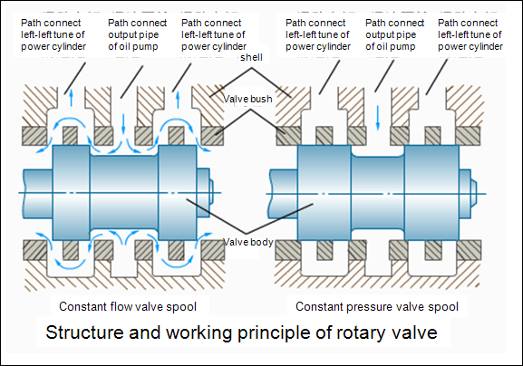
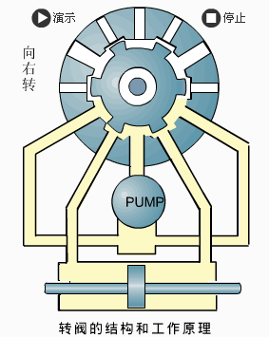
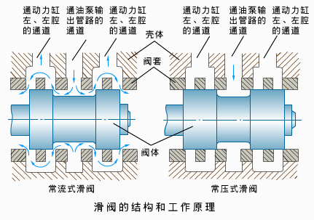
液压助力转向系统的转向控制阀
Steering control valve of hydraulic power steering system

Slide 57
电控液压助力转向系统
Electric control hydraulic power-assistant steering system
在传统液压助力系统基础上加装电控系统，可根据车速调节辅助转向力的大小。
The electric control system is installed on the basis of the traditional hydraulic power-assistant steering system, and the amount of assistant steering force can be adjusted according to the speed.

Slide 58
电动助力转向系统
Electric power-assistant steering system
1) 电动液压式 Electric power-assistant hydraulic steering- EPHS
液压泵与发动机机械解耦，直接由电动机驱动 - The hydraulic pump is mechanically decoupled from the engine and driven directly by the motor.
2) 电动机直接助力式- Electric motor assistant steering –EMAS
直接由电动机提供辅助转向转矩-The auxiliary steering torque is provided directly by the motor.

Slide 59
本章学习重点
Learning focus of this chapter
汽车转向系统的组成；Components of steering system;
两侧转向轮偏转角之间的理想关系式；Ideal relationship between deflection angle of both sides wheel;
汽车转向系统中防止驾驶员身体受伤害的安全防护措施；Safe measures to avoid driver being hurt in steering system;
几种常用转向器的结构特点；Structural features of several steering gear in common use.
典型转向传动机构的组成及布置。Components and layout of typical steering transmission mechanism.

Slide 60
作业Homework
转向系统由哪几部分组成？What’s the components of steering system?
常用的转向器有哪几种类型？What’s types of the steering gear in common use?
何为转向器角传动比、转向传动机构角传动比和转向系统角传动比？为同时满足转向省力和转向灵敏的要求，应采取哪些措施What’s angle ratio of steering gear, steering transmission mechanism angle ratio and steering system angle ratio? To meet the requirements of save manpower and sensitivity of steering, what can we do?
汽车转向系统中一般采用哪些防止驾驶员身体受伤害的安全防护措施？What the safe measures are to avoid the driver being hurt in steering system?

